Slide 1
Fuel Performance
NE 533: Spring 2023

Slide 2
Last Time
Had an exam…
Any feedback?

Slide 3
MOOSE Project
Three-part project
Will upload input and output files to Moodle
Will upload a final written report, 5-10 pages (including figures), times new roman, 12pt, 1.5 space, pdf
Final report is due April 21 – Friday last week of classes
This is an individual project, but some collaboration is encouraged
Part 1 is due Feb 24
just input/output submitted to moodle; 1 page report outlining results
don’t wait until the last minute to do this! ask questions

Slide 4
MOOSE Project Part 1
0.5 cm
0.002 cm
0.1 cm
Fuel pellet dimensions listed
This is a 1-D problem, but I want your geometry to be set up in 2-D RZ
Assume reasonable values for material properties
Can assume constant k
Outer cladding temperature: 600 K
Mesh: something sufficiently converged
Solve temperature profile for:
Steady-state: LHR = 350 W/cm²
Compare against analytical solution
Solve for centerline temperature vs time
Transient: LHR = 500*[(t/100)^0.5]*[(1-(t/100))^4] + 150
for up to t=100
1 cm
Fuel
Cladding
Gap

Slide 5
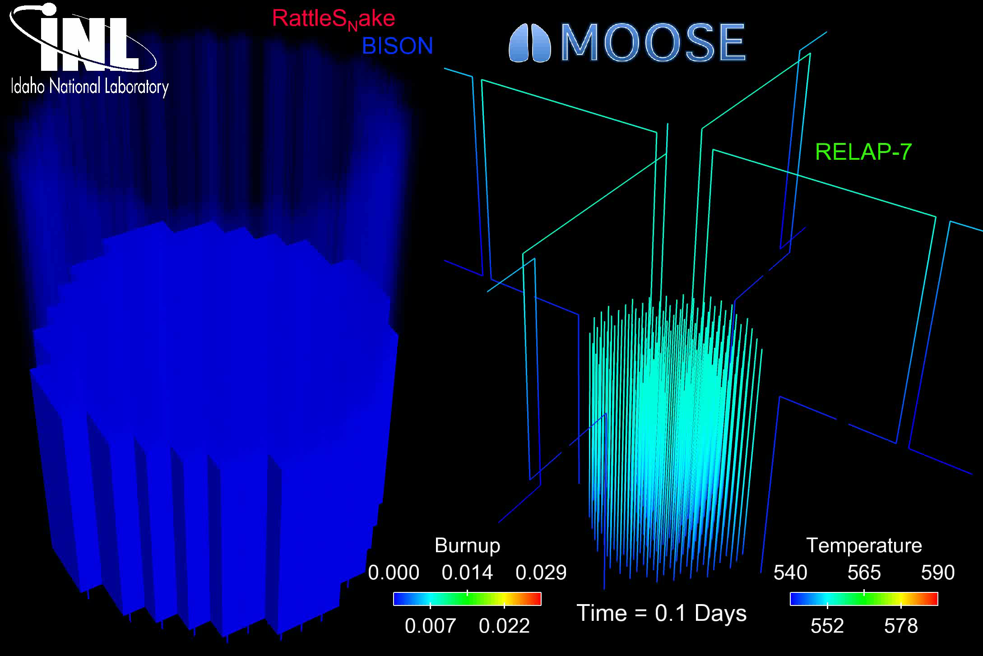
The most accurate solution is numerical, in 3D, requires modeling the entire core, and is multi-physics
Solution is 3D and changes in time
All the properties are functions of temperature
The boundary conditions comes from information about the coolant flow
The heat generation rate comes from information about the neutronics in the reactor
No analytical solution is possible

Slide 6
Numerical time integration

Slide 7
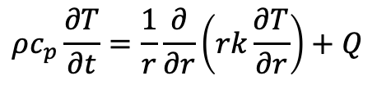
For numerical solutions, deal with discretization in space/time
Discretization in time
Forward Euler’s method (explicit)
Backward Euler’s method (implicit)
Discretization in space
Finite difference
Finite volume
Finite element
$$ρc_{p}\frac{∂T}{∂t}=\frac{1}{r}\frac{∂}{∂r}\left(rk\frac{∂T}{∂r}\right)+Q$$

Slide 8
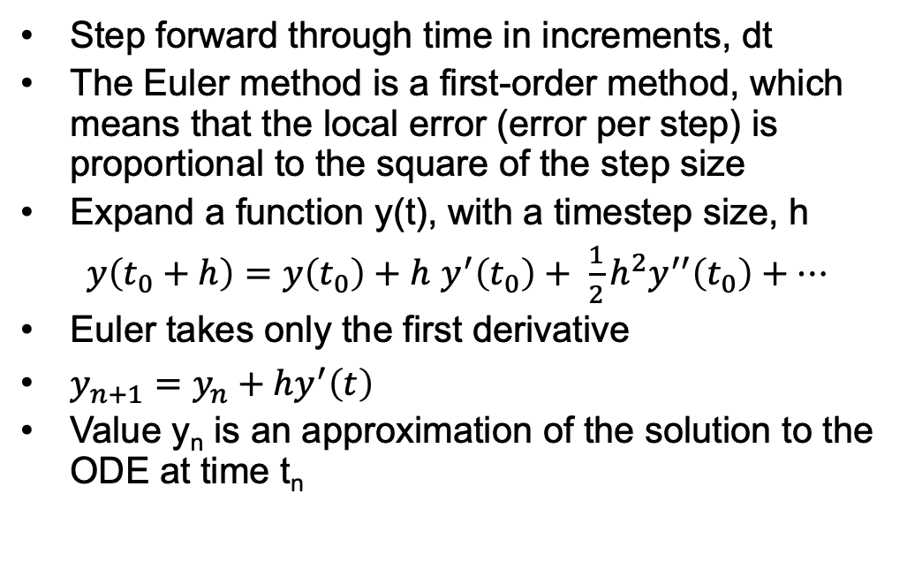
Forward Euler
Step forward through time in increments, dt
The Euler method is a first-order method, which means that the local error (error per step) is proportional to the square of the step size
Expand a function y(t), with a timestep size, h
$y\left(t_{0}+h\right)=y\left(t_{0}\right)+h$ $y^{′}\left(t_{0}\right)+ \frac{1}{2}h^{2}y^{′′}\left(t_{0}\right)+…$
Euler takes only the first derivative
$y_{n+1}=y_{n}+hy^{′}\left(t\right)$
Value y_{n} is an approximation of the solution to the ODE at time t_{n}

Slide 9
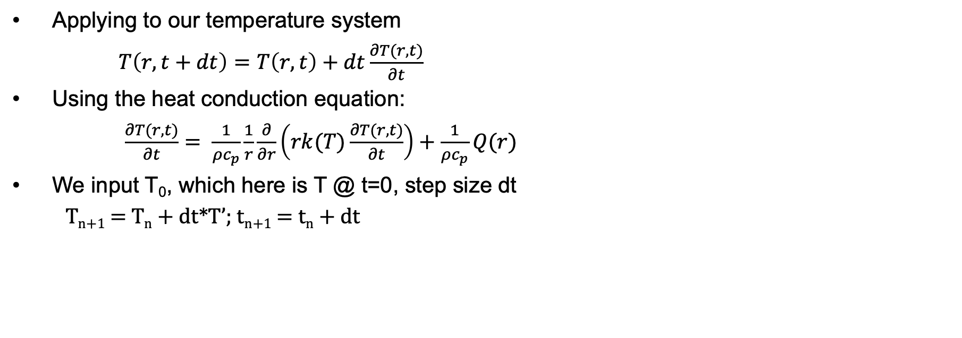
Forward Euler
Applying to our temperature system
$T\left(r,t+dt\right)=T\left(r,t\right)+dt\frac{∂T(r,t)}{∂t}$
Using the heat conduction equation:
$\frac{∂T(r,t)}{∂t}= \frac{1}{ρc_{p}}\frac{1}{r}\frac{∂}{∂r}\left(rk(T)\frac{∂T(r,t)}{∂t}\right)+\frac{1}{ρc_{p}}Q(r)$
We input T₀, which here is T @ t=0, step size dt
T_{n+1} = T_{n} + dt*T’; t_{n+1} = t_{n} + dt
T
t

Slide 10
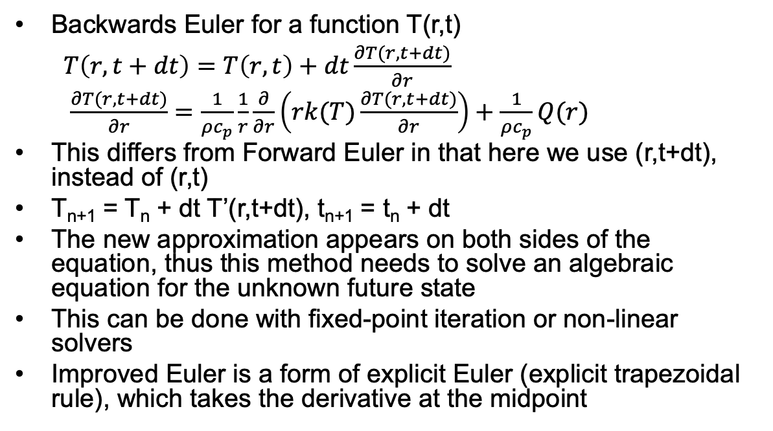
Backwards Euler
Backwards Euler for a function T(r,t)
$T\left(r,t+dt\right)=T\left(r,t\right)+dt\frac{∂T(r,t+dt)}{∂r}$
$\frac{∂T(r,t+dt)}{∂r}=\frac{1}{ρc_{p}}\frac{1}{r}\frac{∂}{∂r}\left(rk(T)\frac{∂T(r,t+dt)}{∂r}\right)+\frac{1}{ρc_{p}}Q(r)$
This differs from Forward Euler in that here we use (r,t+dt), instead of (r,t)
T_{n+1} = T_{n} + dt T’(r,t+dt), t_{n+1} = t_{n} + dt
The new approximation appears on both sides of the equation, thus this method needs to solve an algebraic equation for the unknown future state
This can be done with fixed-point iteration or non-linear solvers
Improved Euler is a form of explicit Euler (explicit trapezoidal rule), which takes the derivative at the midpoint
t

Slide 11
Explicit vs Implicit
Forward Euler is explicit
Explicit methods calculate the state of a system at a later time from the state of the system at the current time
Can be unstable if step size is too much
Backwards Euler is implicit
Implicit methods find a solution by solving an equation involving both the current state of the system and a later state
Implicit require an extra computation and they can be much harder to implement
Implicit methods are used because many problems arising in practice are stiff, for which the use of an explicit method requires very small timesteps

Slide 12
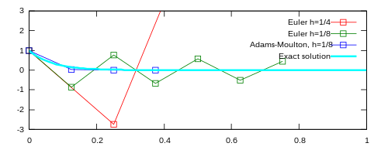
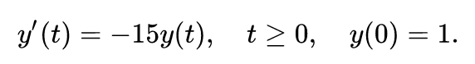
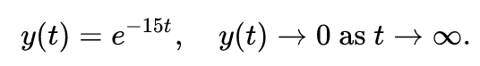
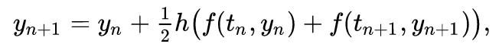
Stiff Equations
A stiff equation is a differential equation for which certain numerical methods for solving the equation are numerically unstable, unless the step size is taken to be extremely small
Consider the problem:
Where the exact solution is:
Euler's method with a step size of ℎ=1/4 oscillates wildly
Euler's method with half the step size, ℎ=/18, produces a solution within the graph boundaries, but oscillates about zero
The trapezoidal method (similar to backwards Euler) is implicit, and converges to the correct solution

Slide 13
Example Problem

Slide 14
Example Problem
y’=t*exp(-2t)
y0=4
dt=0.5
Backwards Euler

Slide 15
Spatial discretization

Slide 16
Spatial resolution
To numerically solve in space, we need to discretize
Finite difference
convert differential equations into a system of equations that can be solved by matrix algebra techniques
Finite volume
volume integrals in a partial differential equation that contain a divergence term are converted to surface integrals, using the divergence theorem. These terms are then evaluated as fluxes at the surfaces of each finite volume
Finite element
subdivides a large system into smaller, simpler parts that are called finite elements, the equations that model these finite elements are then assembled into a larger system of equations that models the entire problem

Slide 17
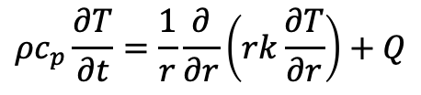
Finite Difference
$$ρc_{p}\frac{∂T}{∂t}=\frac{1}{r}\frac{∂}{∂r}\left(rk\frac{∂T}{∂r}\right)+Q$$
The finite difference method solves on a grid and uses numerical derivatives
Derivatives are approximated by differences
Boundary conditions must have either a fixed T or dT/dr
Typically restricted to handle rectangular shapes
Once you compute the time derivative, you can use either forward or backward Euler to march through time
T(r, t)
T(r + h, t)
T(r – h, t)

Slide 18
Finite Volume
$$ρc_{p}\frac{∂T}{∂t}=\frac{1}{r}\frac{∂}{∂r}\left(rk\frac{∂T}{∂r}\right)+Q$$
Discretize the domain by subdomains
Domain size h
We place points in the subdomain centers and on either boundary
The finite volume method balances fluxes across the boundaries of your divided subdomains
Integrate our PDE across the subdomain
Evaluate the integral using a linear approximation of the variable
Restricted to flux boundary conditions, often used in flow-type problems

Slide 19
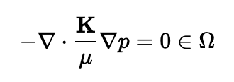
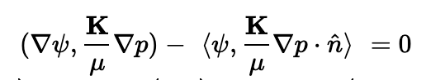
Finite Element
$$ρc_{p}\frac{∂T}{∂t}=\frac{1}{r}\frac{∂}{∂r}\left(rk\frac{∂T}{∂r}\right)+Q$$
In the finite element method, we interpolate the variable using nodal values and integrate over elements
Systematically recombine all sets of element equations into a global system of equations for the final calculation
Write the strong form of the equation, rearrange to get zero on the right-hand side, multiply by the test function, integrate over the domain, yielding weak form
The strong form states conditions that must be met at every material point, whereas weak form states conditions that must be met only in an average sense
Finite element works for any geometry and any boundary condition
e1
e2
e3
n1 n2 n3 n4

Slide 20
Spatial resolution
Finite difference
Advantages
Simple
Easy to code
Fast
Disadvantages
Difficult to model complex geometries
Difficult to model complex BCs
Only represents solution at points
Difficult to represent heterogeneous properties
Finite Volume
Advantages
Can model any geometry
Naturally conservative
Heterogeneous properties
Disadvantages
Boundary conditions add complexity
More complicated than finite difference
Finite Element
Advantages
Can model any geometry
Can model any BC
Continuous representation
Heterogeneous properties
Disadvantages
Complicated
Somewhat more expensive

Slide 21
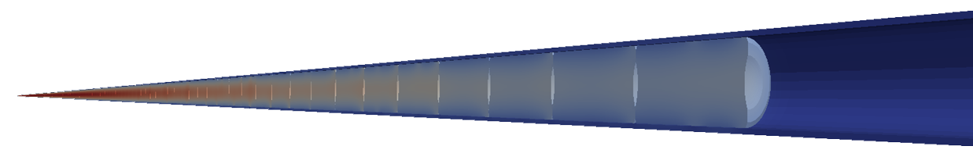
Different Fuel Performance Problems
Transient, full 3D
Transient, 2D axisymmetric with discrete pellets
Computational cost
Transient, 2D axisymmetric with smeared pellets
Accuracy
Transient, multiple 1D slices (1.5D)
Transient, 1D
Steady state, 1D (analytical)

Slide 22
Numerical Approaches to Different Fuel Performance Problems
Transient, full 3D
FEM or FV
Transient, 2D axisymmetric with discrete pellets
FEM or FV
Computational cost
Transient, 2D axisymmetric with smeared pellets
FEM, FV, or FD
Accuracy
Transient, multiple 1D slices (1.5D)
FEM, FV, or FD
Transient, 1D
FEM, FV, or FD
Steady state, 1D (analytical)

Slide 23
Heat equation solution approach summary
Approach | Solution | Assumptions
1D steady state | Analytical | Steady state, axisymmetric, no axial variation, constant k
1D transient | FEM, FD, FV | Axisymmetric, no axial variation
1.5D transient | FEM, FD, FV with multiple slices | Axisymmetric, no axial variation
2D transient, smeared pellets | FEM, FD, FV | Axisymmetric, fuel pellets act as one body, fuel pellets are perfect cylinders
2D transient, discrete pellets | FEM, FV | Axisymmetric
3D transient | FEM, FV | You have a big computer
Each numerical solution can be solved explicitly or implicitly

Slide 24
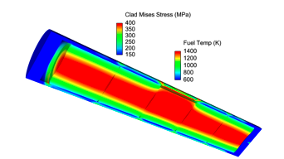
Solving with fuel performance codes
Fuel performance codes primarily use either finite difference or finite element
The earliest fuel performance codes solved the heat equation in 1.5D using finite difference (with multiple axial slices)
More modern codes have switched to finite element, due to more flexibility with geometry and boundary conditions
Finite volume is becoming an option

Slide 25
Summary
The heat equation can be solved using numerical methods.
Spatial derivative solution methods divide the domain up into smaller pieces
Finite difference
Finite volume
Finite element
Each discretization has strengths/weaknesses
Finite element is primary method for high fidelity fuel performance codes

Slide 26
Mechanics

Slide 27

Solid mechanics
When a load is applied to a body, it changes shape and perhaps size
Motions throughout a body are called displacements
u(r, t)
Rigid body displacements do not change the shape and/or size
the rigid body is translated
Changes in shape and/or size are call deformations
The objective of Solid Mechanics is to relate loads (applied force) to deformation

Slide 28
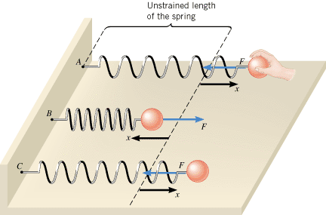
Ideal springs
It can be instructive to view solids as a spring
When we apply some force F, we get some displacement x
F = k x
When the spring is displaced by x, there is force that responds in the opposite direction equal to kx
Due to the displacement, there is a stored energy E = ½ k x²

Slide 29
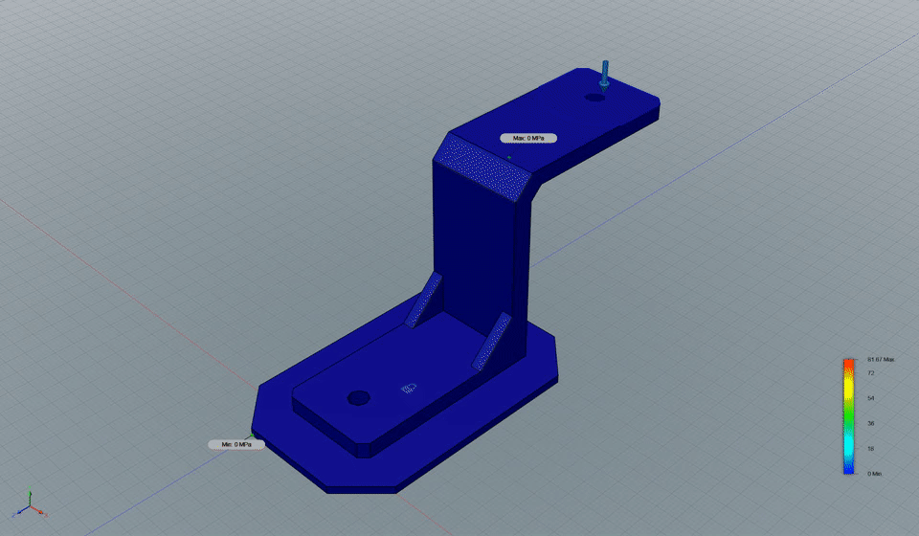
Observed deformation due to a force
Solid mechanics is similar to the behavior of an ideal spring but throughout a body
An applied load results results in deformation.
The internal strain is like the displacements x
The internal stress is like the internal force F

Slide 30
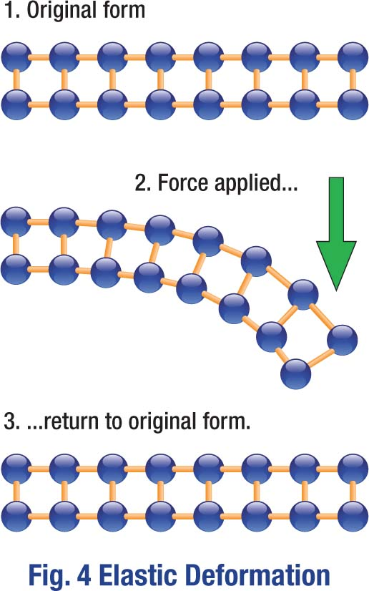
Elasticity
Elasticity is the ability of a body to resist a distorting influence and to return to its original size and shape when that influence or force is removed
In elastic deformation, we are stretching the atomic bonds
The more we stretch the bonds, the more force it takes to stretch
When we release the load, the atoms spring back into their lattice sites

